Slide 1

REMOTE SENSING
Department of Mechatronics Engineering
INTERNATIONAL ISLAMIC UNIVERSITY MALAYSIA

Slide 2

BASIC CONCEPTS OF REMOTE SENSING (RS)
Prepared by:
Azhar Bin Mohd Ibrahim (Ph.D. Universiti Sains Malaysia)
azhar_ibrahim@iium.edu.my

Slide 3
INTRODUCTION
Remote sensing is an art and science of obtaining information about an object or feature without physically coming in contact with that object or feature.
Human: vision, hearing and sense of smell.
Data collected: variations in acoustic wave distributions (e.g., sonar), variations in force distributions (e.g., gravity meter), variations in electromagnetic energy distributions (e.g., eye) etc
Remotely collected data through various sensors may be analyzed to obtain information about the objects or features under investigation
Remote Sensing: electromagnetic energy sensors
Remote Sensing vs Photogrammetry

Slide 4
Remote sensing: i) process of inferring surface parameters from measurements of the electromagnetic radiation (EMR) from the object’s surface.
This EMR can either be reflected or emitted from the object’s surface.
ii) Detecting and measuring electromagnetic (EM) energy emanating or reflected from distant objects made of various materials, so that we can identify and categorize these objects by class or type, substance and spatial distribution.

Slide 5
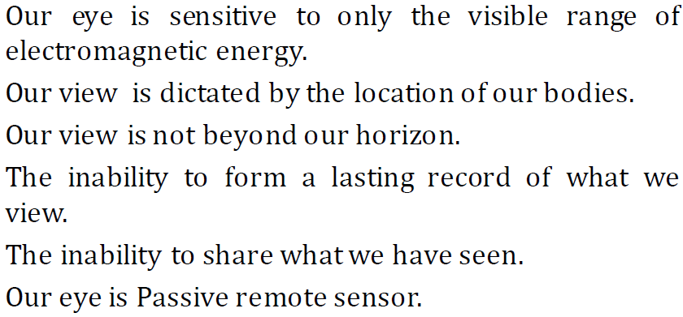
Why not our eyes?

Slide 6
Applications of remote sensing
Determining soil moisture content: Soil moisture contributes so much to understanding Earth sciences. For example, it explains Earth’s water cycle, weather forecasting, drought and floods. https://smap.jpl.nasa.gov/
Mapping with laser precision using Light Detection and Ranging technology: LiDAR (Light Detection and Ranging) measures the distance from the airborne platform to Earths surface using laser beams. LiDAR generates point clouds for digital surface models, digital elevation models and light intensity models. https://gisgeography.com/dem-dsm-dtm-differences/

Slide 7

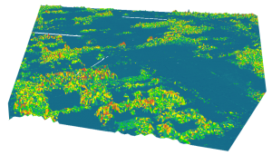
A DSM is useful in 3D modeling for telecommunications, urban planning and aviation.
RUNWAY APPROACH ZONE ENCROACHMENT: In aviation, DSMs can determine runway obstructions in the approach zone.
VEGETATION MANAGEMENT: Along a transmission line, DSMs can see where and how much vegetation is encroaching.
VIEW OBSTRUCTION: Urban planners use DSM to check how a proposed building would affect the viewshed of residents and businesses.
Digital Surface Model (DSM) – Extruding features are tree canopy
Digital Surface Model: In a Lidar system, pulses of light travel to the ground. When the pulse of light bounces off its target and returns to the sensor, it gives the range (a variable distance) to the Earth. In the end, LiDAR delivers a massive point cloud filled of varying elevation values. Height can come from the top of buildings, tree canopy, powerlines and other features. A DSM captures the natural and built features on the Earth’s surface.

Slide 8
Catching tax-evaders red-handed by locating new construction and building alterations: The tax revenue agency in Athens, Greece is looking for signs of wealth using satellite data. Not a bad idea where more than 15,000 swimming pools went unclaimed to tax authorities in 2010. The money-strapped country is looking at increasing their tax revenues using remote sensing applications using satellite imagery.

Slide 9
Charging higher insurance premiums in flood-prone areas using radar
It wasn’t until very recently that insurance companies started to understand the benefits of GIS. Location intelligence becomes relevant because insurance claims are 100% location-based – it just makes sense.
RISK ASSESSMENT uses geographic information to predict risk.
Higher risk means higher premiums. Lower premiums are for areas with less risk.
Insurance companies divide areas into territories. These territories can be assessed piece-by-piece with risk. People living on a coastline in an area with hurricanes will pay higher premiums. Every hurricane has been mapped in the past.
Disaster management services such as flood and drought warning and monitoring, damage assessment in case of natural calamities, environmental monitoring, urban planning etc.

Slide 10
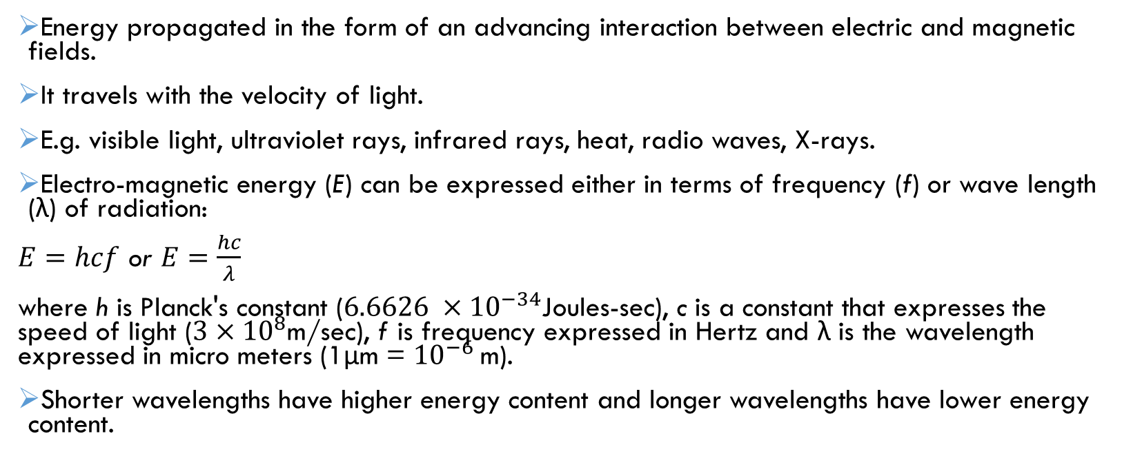
Electromagnetic Energy / electromagnetic radiation (EMR)
Energy propagated in the form of an advancing interaction between electric and magnetic fields.
It travels with the velocity of light.
E.g. visible light, ultraviolet rays, infrared rays, heat, radio waves, X-rays.
Electro-magnetic energy (E) can be expressed either in terms of frequency (f) or wave length (λ) of radiation:
$E=hcf$ or $E=\frac{hc}{λ}$
where h is Planck's constant ($6.6626 ×{10}^{−34}$Joules-sec), c is a constant that expresses the speed of light ($3×{10}^{8}$m/sec), f is frequency expressed in Hertz and λ is the wavelength expressed in micro meters (1μm = ${10}^{−6}$m).
Shorter wavelengths have higher energy content and longer wavelengths have lower energy content.

Slide 11
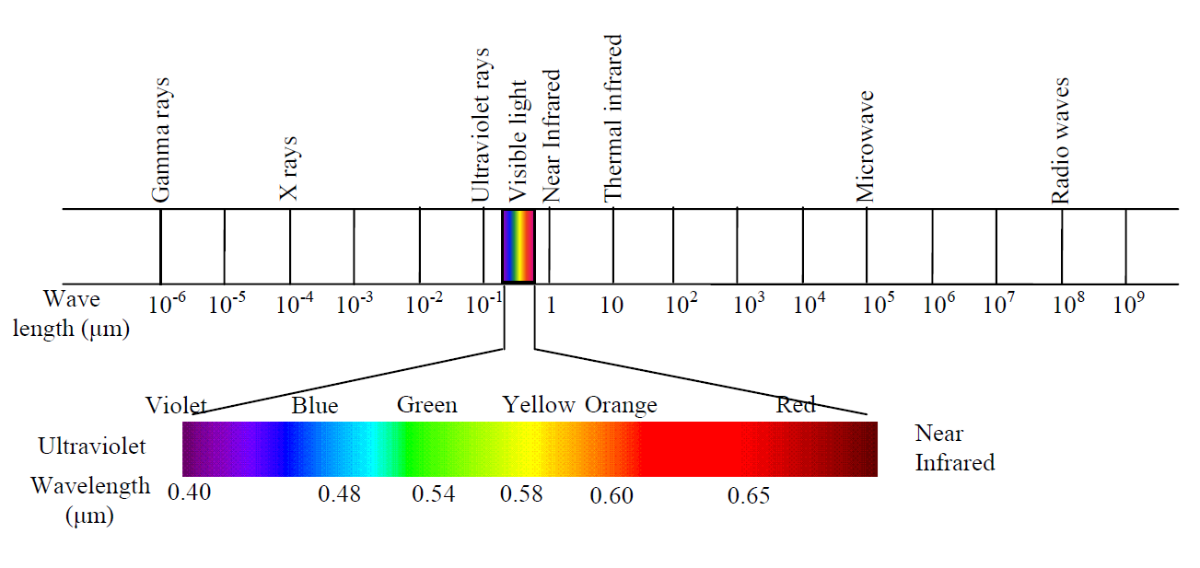
Electromagnetic radiation spectrum
Distribution of the continuum of energy can be plotted as a function of wavelength
All matters reflect, emit or radiate a range of electromagnetic energy, depending upon the material characteristics.
Measurement of electromagnetic radiation reflected or emitted from an object; used to identify the target and to infer its properties.

Slide 12
Overview of remote sensing
Different objects reflect or emit different amounts of energy in different bands of the electromagnetic spectrum.
The amount of energy reflected or emitted depends on the properties of both the material and the incident energy (angle of incidence, intensity and wavelength).
Detection and discrimination of objects or surface features is done through the uniqueness of the reflected or emitted electromagnetic radiation from the object.
Sensor: a device to detect this reflected or emitted electro-magnetic radiation from an object (e.g., cameras and scanners).
Platform: A vehicle used to carry the sensor (e.g., aircrafts and satellites).

Slide 13
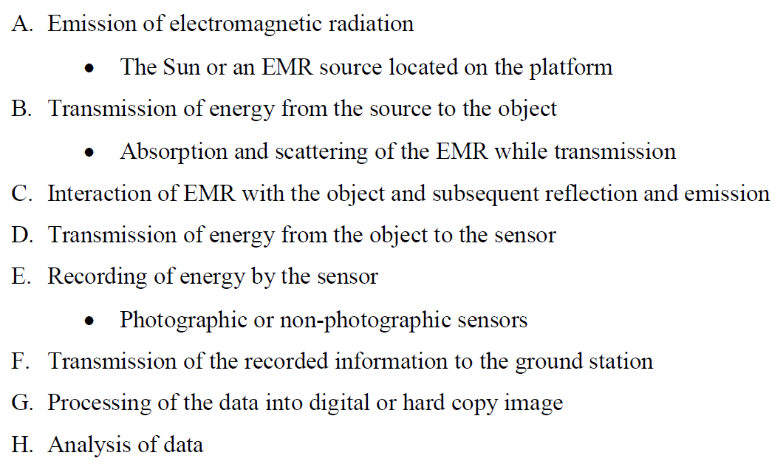
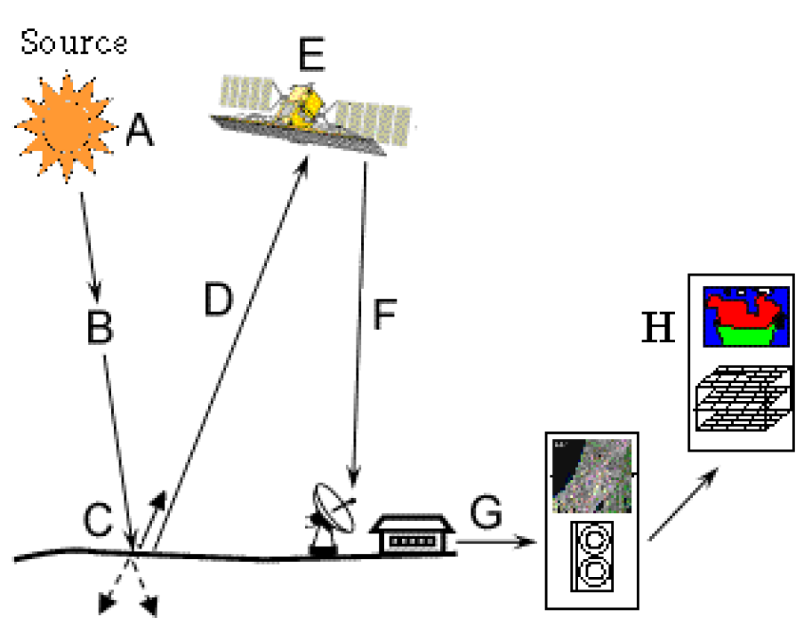

Slide 14
Types of remote sensing: active / passive
Passive remote sensing: source of energy is natural, the Sun.
Solar energy reflected by the targets at specific wavelength bands are recorded using sensors onboard air-borne or space borne platforms.
How to ensure ample signal strength received at the sensor?
By using wavelength / energy bands capable of traversing through the atmosphere, without significant loss through atmospheric interactions
Any object which is at a temperature above 0˚ K (Kelvin) emits some radiation.
Earth ambient temperature is about 300 ˚ K, thus it emits some radiation. However, not preferred as the energy content is very low.

Slide 15
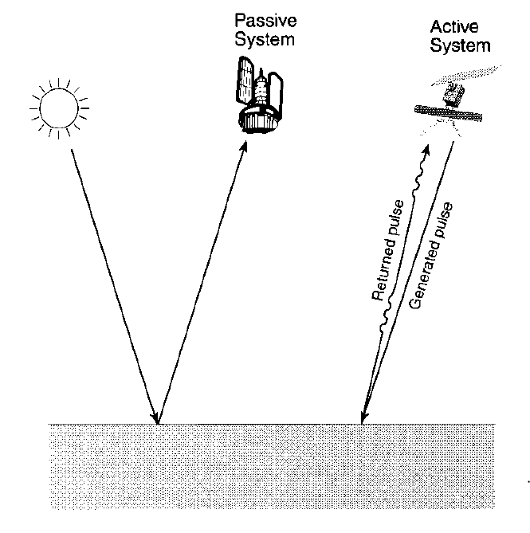
active rs
Energy is generated and sent from the remote sensing platform towards the targets.
The energy reflected back from the targets are recorded using sensors onboard the remote sensing platform.
Most of the microwave remote sensing is done through active remote sensing.
Analogy between active and passive RS.
Taking picture: Passive: normal, Active: with flash

Slide 16
Air-borne vs space-borne rs
Air-borne RS | Space-borne RS
Downward or sideward looking sensors mounted on aircrafts are used to obtain images of the earth's surface | Sensors mounted on space shuttles or satellites orbiting the Earth are used.
Very high spatial resolution images | Satellite imagery has a lower resolution
Less coverage area | Large area coverage
High cost per unit area of ground coverage | Less cost per unit area of coverage
One-time operation | Continuous monitoring of the earth features
LiDAR, analog aerial photography, videography, thermal imagery and digital photography | Landsat satellites, RazakSAT, IKONOS, SPOT satellites, AQUA and TERRA of NASA and INSAT satellite

Slide 17
Ideal rs
1) Energy Source
2) Atmosphere
3) Earth Surface
4) Sensor
5) Data Handling System
6) Data Users

Slide 18
Ideal RS | Real RS
A Uniform Energy Source which provides energy over all wavelengths, at a constant, known, high level of output | The energy sources for real systems are usually non-uniform over various wavelengths and also vary with time and space. This has major effect on the passive remote sensing systems. The spectral distribution of reflected sunlight varies both temporally and spatially. Earth surface materials also emit energy to varying degrees of efficiency. A real remote sensing system needs calibration for source characteristics.

Slide 19
Ideal RS | Real RS
A Non-interfering Atmosphere which will not modify either the energy transmitted from the source or emitted (or reflected) from the object in any manner. | The atmosphere modifies the spectral distribution and strength of the energy received or emitted. The effect of atmospheric interaction varies with the wavelength associated, sensor used and the sensing application. Calibration is required to eliminate or compensate these atmospheric effects.

Slide 20
Ideal RS | Real RS
A Series of Unique Energy/Matter Interactions at the Earth's Surface which generate reflected and/or emitted signals that are selective with respect to wavelength and also unique to each object or earth surface feature type. | Remote sensing is based on the principle that each and every material reflects or emits energy in a unique, known way. However, spectral signatures may be similar for different material types. This makes differentiation difficult. Also, the knowledge of most of the energy/matter interactions for earth surface features is either at elementary level or even completely unknown.

Slide 21
Ideal RS | Real RS
A Super Sensor which is highly sensitive to all wavelengths. A super sensor would be simple, reliable, accurate, economical, and requires no power or space. This sensor yields data on the absolute brightness (or radiance) from a scene as a function of wavelength. | Real sensors have fixed limits of spectral sensitivity i.e., they are not sensitive to all wavelengths. Also, they have limited spatial resolution (efficiency in recording spatial details). For example, while photographic systems have very good spatial resolution and poor spectral sensitivity, non-photographic systems have poor spatial resolution.

Slide 22
Ideal RS | Real RS
A Real-Time Data Handling System which generates the instance radiance versus wavelength response and processes into an interpretable format in real time. | Human intervention is necessary for processing sensor data; even though machines are also included in data handling. This makes the idea of real time data handling almost impossible. The amount of data generated by the sensors far exceeds the data handling capacity.

Slide 23
Ideal RS | Real RS
Multiple Data Users having knowledge in their respective disciplines and also in remote sensing data acquisition and analysis techniques. The information collected will be available to them faster and at less expense. This information will aid the users in various decision making processes and also further in implementing these decisions. | The success of any remote sensing mission lies on the user who ultimately transforms the data into information. This is possible only if the user understands the problem thoroughly and has a wide knowledge in the data generation. The user should know how to interpret the data generated and should know how best to use them.

Slide 24
Emr spectrum-introduction
Parameters of the target are measured without being in touch with it.
Need some processes which convey those parameters to the sensor is required.
A best example – our eyes: solar light hits objects and gets reflected and captured in our eyes. identify the properties of the objects when these signals captured in our eyes are transferred to the brain analysed.
Analogous to the man-made remote sensing techniques.

Slide 25
EMR emitted / reflected by the targets → recorded → analysed to interpret the target characteristics.
Depend on the characteristics of the source of radiation / energy, characteristics of the target and the atmospheric interactions.

Slide 26
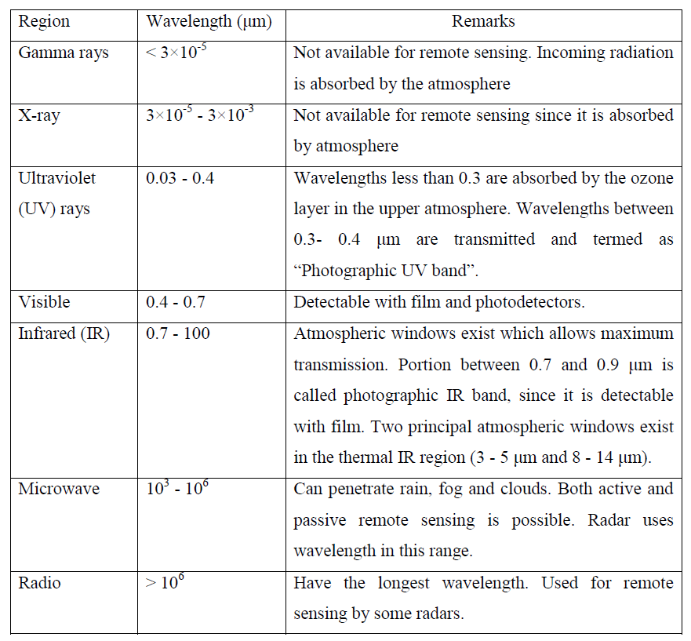
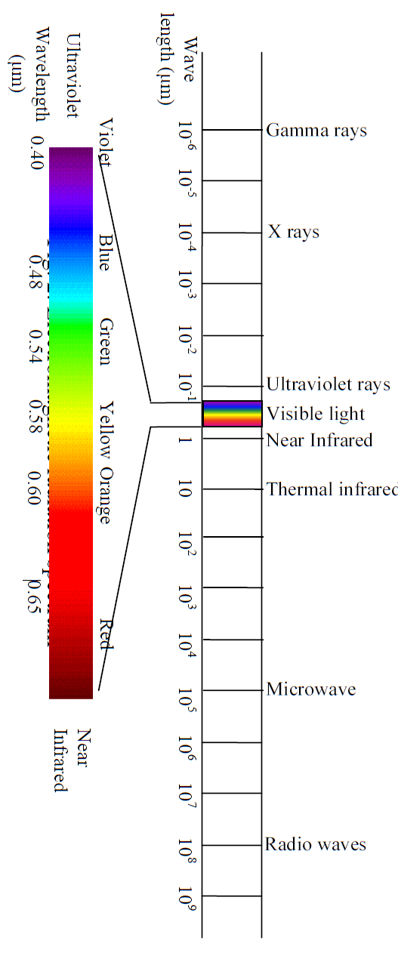
Spectrum of electromagnetic radiation

Slide 27
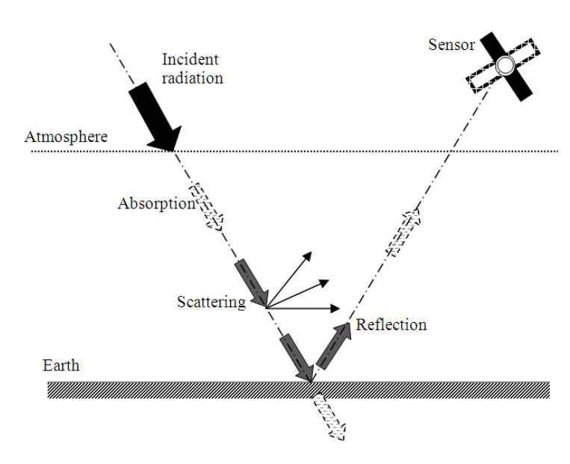

Slide 28
Energy sources and radiation principles
Primary source: the Sun.
Solar radiation (also called insolation) arrives at the Earth at wavelengths determined by the photosphere temperature of the sun (peaking near 5,600 °C).
Although the Sun produces electromagnetic radiation in a wide range of wavelengths, the amount of energy it produces is not uniform across all wavelengths.
Almost 99% of the solar energy is within the wavelength range of 0.28-4.96 μm. Within this range, 43% is radiated in the visible wavelength region between 0.4-0.7 μm. The maximum energy (E) is available at 0.48 μm wave length, which is in the visible green region.
The solar irradiance (power of electromagnetic radiation per unit area incident on a surface) distribution of the Sun.

Slide 29
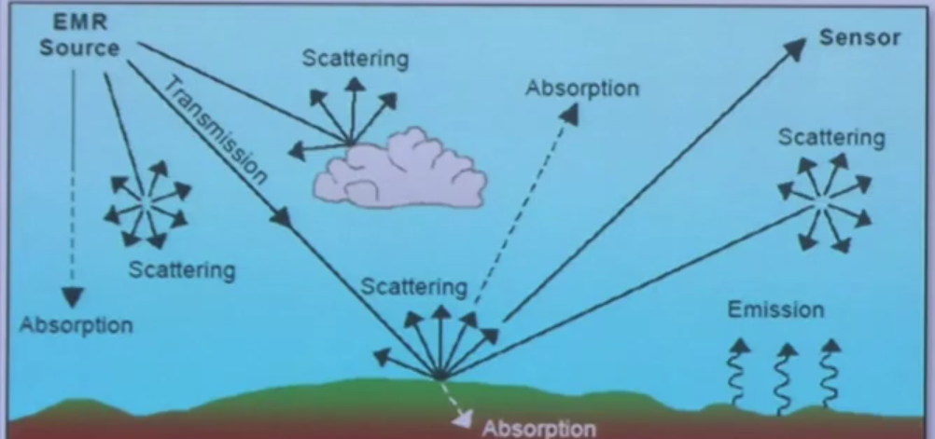
Scattering
Atmospheric scattering is the process by which small particles in the atmosphere diffuse a portion of the incident radiation in all directions.
There is no energy transformation while scattering.
But the spatial distribution of the energy is altered during scattering.
Rayleigh scattering, Mie scattering, Non-selective scattering

Slide 30
Rainbow??
Blue sky??
Sunrise and sunset→ orange + red??
Cloud??
Haze??

Slide 31
A rainbow is a meteorological phenomenon that is caused by reflection, refraction and dispersion of light in water droplets resulting in a spectrum of light appearing in the sky.

Slide 32
Molecules of Oxygen and Nitrogen (which are dominant in the atmosphere) cause this type of scattering of the visible part of the electromagnetic radiation.
Within the visible range, smaller wavelength blue light is scattered more compared to the green or red.
The blue light is scattered around 4 times and UV light is scattered about 16 times as much as red light. This consequently results in a blue sky.
At sunrise and sunset, the sun's rays have to travel a longer path, causing complete scattering (and absorption) of shorter wavelength radiations.
As a result, only the longer wavelength portions (orange and red) which are less scattered will be visible.

Slide 33
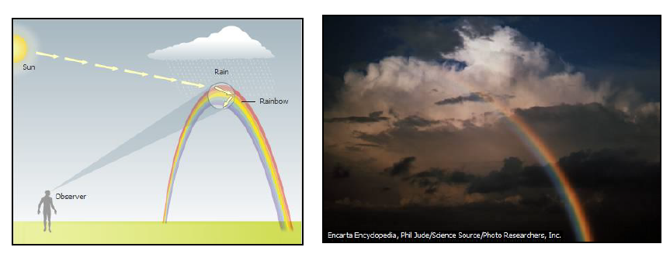
For visible light (of wavelength 0.4-0.7μm), non-selective scattering is generally caused by water droplets which is having diameter commonly in the range of 5 to 100 μm.
This scattering is nonselective with respect to wavelength since all visible and IR wavelengths get scattered equally giving white or even grey color to the clouds.

Slide 34
Absorption
Incident energy is retained by particles in the atmosphere at a given wavelength.
Not only absorb a portion of the total energy, but will also reflect, refract or scatter the energy. The absorbed energy may also be transmitted back to the atmosphere.
The most efficient absorbers of solar radiation are water vapour, carbon dioxide, and ozone.
Gaseous components of the atmosphere are selective absorbers of the electromagnetic radiation, i.e., these gases absorb electromagnetic energy in specific wavelength bands.
Even though all the wavelengths from the Sun reach the top of the atmosphere, due to the atmospheric absorption, only limited wavelengths can pass through the atmosphere.
The ranges of wavelength that are partially or wholly transmitted through the atmosphere are known as "atmospheric windows."
RS data acquisition is limited through these atmospheric windows.

Slide 35
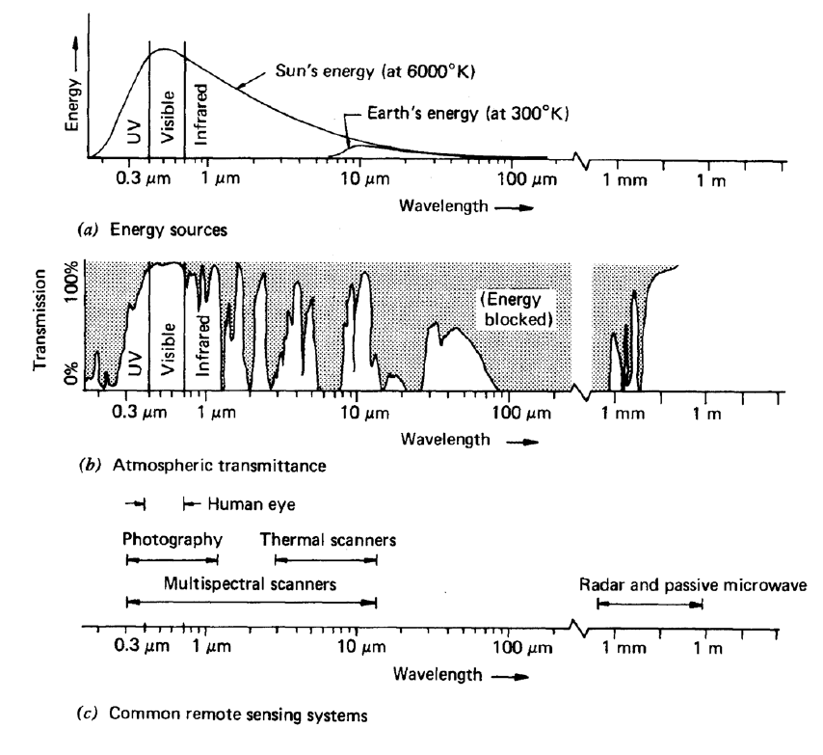
atmospheric windows

Slide 36
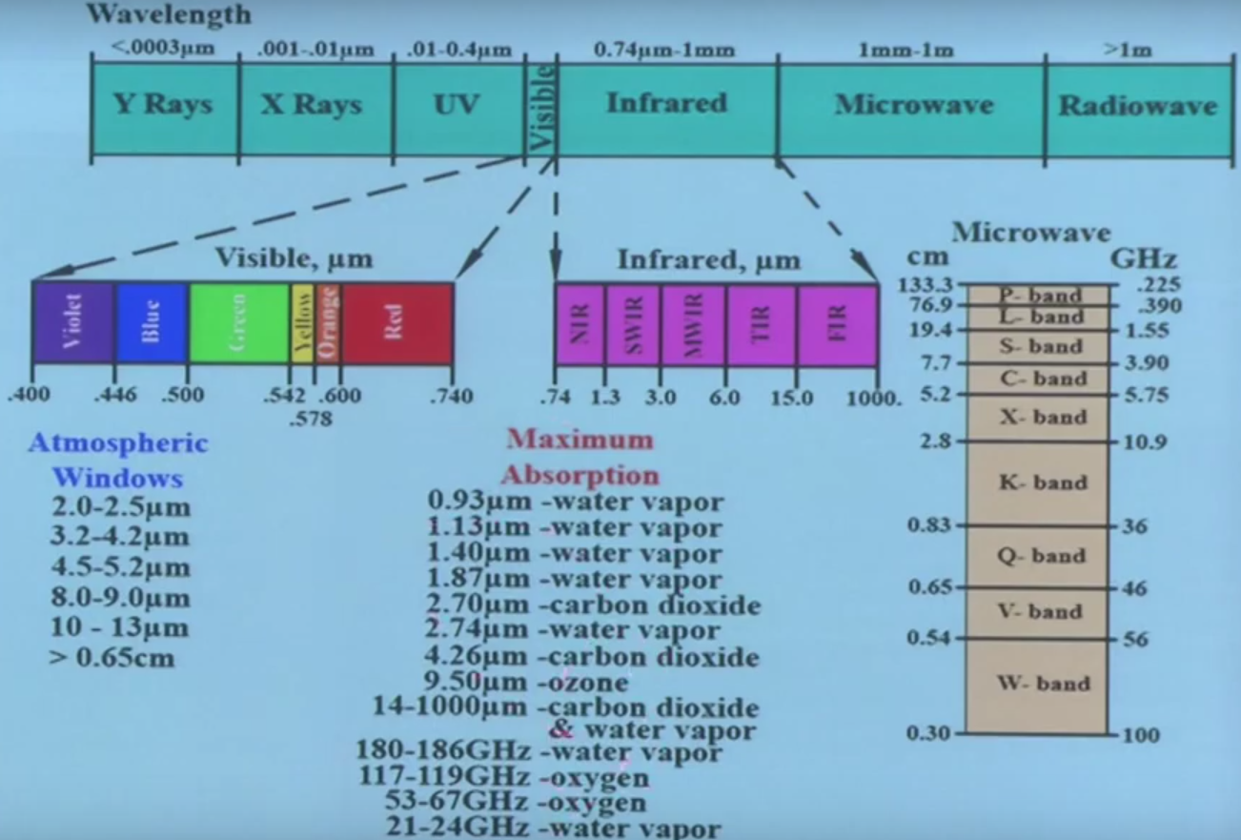

Slide 37
spectral reflectance curves
The energy that is reflected by features on the earth's surface over a variety of different wavelengths will give their spectral responses.
The graphical representation of the spectral response of an object over different wavelengths of the electromagnetic spectrum is termed as spectral reflectance curve.
These curves give an insight into the spectral characteristics of different objects, hence used in the selection of a particular wavelength band for remote sensing data acquisition.

Slide 38
The main difference between coniferous (also called evergreen) and deciduous trees is that deciduous trees lose their leaves every year and most conifers do not
Spectral reflectance curves for deciduous (broad-leaved) and coniferous (needle-bearing) trees.
Overlapping in most of the visible portion.
In the near infra red (NIR) they are quite different and distinguishable.

Slide 39
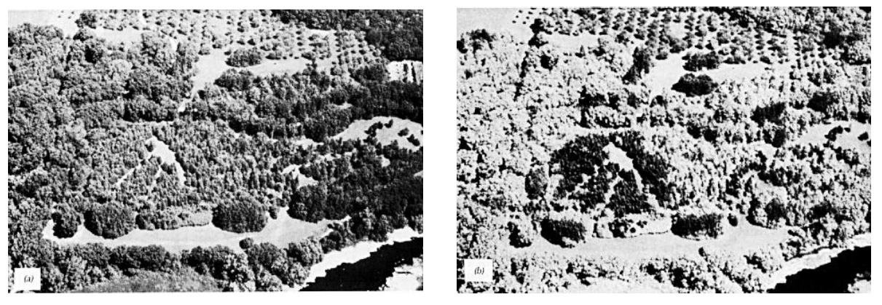
(a) Panchromatic photograph using reflected sunlight over the visible wavelength band 0.4 to 0.7 mm and (b) Black and white infrared photograph using reflected sunlight over 0.7 to 0.9 mm wavelength band (Lillesand et al., 2004)
panchromatic refers to black and white imagery that is exposed by all visible light

Slide 40
Spectral Reflectance Curve for Vegetation
The valleys in the visible portion of the spectrum are due to the pigments in plant leaves. The palisade cells containing sacs of green pigment (chlorophyll) strongly absorb energy in the wavelength bands centered at 0.45 and 0.67 μm within visible region (corresponds to blue and red).
On the other hand, reflection peaks for the green colour in the visible region, which makes our eyes perceive healthy vegetation as green in colour. However, only 10-15% of the incident energy is reflected in the green band.

Slide 41
In the reflected infrared portion (or near infrared, NIR) of the spectrum, at 0.7 μm, the reflectance of healthy vegetation increases dramatically.
In the range from 0.7 to 1.3 μm, a plant leaf reflects about 50 percent of the energy incident upon it. The infrared radiation penetrates the palisade cells and reaches the irregularly packed mesophyll cells which make up the body of the leaf.
Mesophyll cells reflect almost 60% of the NIR radiation reaching this layer. Most of the remaining energy is transmitted, since absorption in this spectral region is minimal.
Healthy vegetation therefore shows brighter response in the NIR region compared to the green region. As the leaf structure is highly variable between plant species, reflectance measurements in this range often permit discrimination between species, even if they look same in visible wavelengths

Slide 42
If a plant is subjected to some form of stress that interrupts its normal growth and productivity, it may decrease or cease chlorophyll production.
The result is less absorption in the blue and red bands in the palisade. Hence, red and blue bands also get reflected along with the green band, giving yellow or brown colour to the stressed vegetation.
Also in stressed vegetation, the NIR bands are no longer reflected by the mesophyll cells, instead they are absorbed by the stressed or dead cells causing dark tones in the image

Slide 43
Beyond 1.3 μm, energy incident upon the plants is essentially absorbed or reflected, with little to no transmittance of energy.
Dips in reflectance occur at 1.4, 1.9, and 2.7 μm as water in the leaf strongly absorbs the energy at these wavelengths.
So, wavelengths in these spectral regions are referred to as water absorption bands. Reflectance peaks occur at 1.6 and 2.2 μm, between the absorption bands.

Slide 46
Similar to the reflection and absorption, transmittance of the electromagnetic radiation by the vegetation also varies with wavelength.
Transmittance of electromagnetic radiation is less in the visible region and it increases in the infrared region. Vegetation canopies generally display a layered structure.
Therefore, the energy transmitted by one layer is available for reflection or absorption by the layers below it.
Due to this multi-layer reflection, total infrared reflection from thicker canopies will be more compared to thin canopy cover.
From the reflected NIR, the density of the vegetation canopy can thus be interpreted.

Slide 47
Spectral Reflectance of Soil
Some of the factors effecting soil reflectance are moisture content, soil texture (proportion of sand, silt, and clay), surface roughness, presence of iron oxide and organic matter content. These factors are complex, variable, and interrelated.
For example, the presence of moisture in soil decreases its reflectance. As with vegetation, this effect is greatest in the water absorption bands at 1.4, 1.9, and 2.7 μm. On the other hand, similar absorption characteristics are displayed by the clay soils. Clay soils have hydroxyl ion absorption bands at 1.4 and 2.2 μm.

Slide 48
Soil moisture content is strongly related to the soil texture.
For example, coarse, sandy soils are usually well drained, resulting in low moisture content and relatively high reflectance. On the other hand, poorly drained fine textured soils generally have lower reflectance. In the absence of water, however, the soil itself exhibits the reverse tendency i.e., coarse textured soils appear darker than fine textured soils.

Slide 51
Spectral Reflectance for Water
Water provides a semi-transparent medium for the electromagnetic radiation. Thus the electromagnetic radiations get reflected, transmitted or absorbed in water. The spectral responses vary with the wavelength of the radiation and the physical and chemical characteristics of the water.
Spectral reflectance of water varies with its physical condition. In the solid phase (ice or snow) water give good reflection at all visible wavelengths. On the other hand, reflection in the visible region is poor in case of water in liquid stage. This difference in reflectance is due to the difference in the atomic bond in the liquid and solid states.

Slide 52
Water in the liquid form shows high reflectance in the visible region between 0.4μm and 0.6μm. Wavelengths beyond 0.7μm are completely absorbed. Thus clear water appears in darker tone in the NIR image.

Slide 54
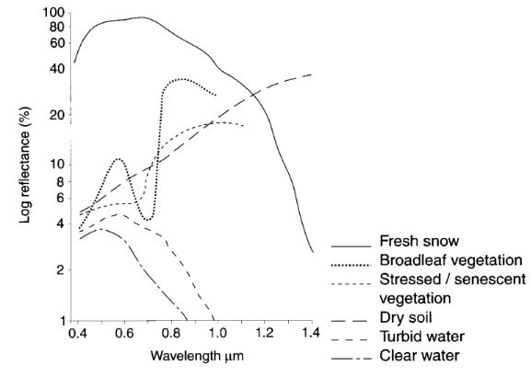
Sample spectral reflectance curves of some of the natural features like snow, healthy vegetation, stressed vegetation, dry soil, turbid water and clear water

Slide 55
Aerial photographs of a stadium in normal colour and colour IR

Slide 56
In normal colour photograph, the artificial turf inside the stadium and the natural vegetation outside the stadium appear in the same colour. On the other hand, the IR colour photograph helps to differentiate both very clearly. The artificial turf appears dark in tone, whereas the natural vegetation shows high reflectance in the IR region.
Spectral reflectance curves of the natural vegetation and the artificial turf

Slide 57
Resolution
Spectral Signature:
https://speclib.jpl.nasa.gov/library
The resolution is the minimum distance between two objects that can be distinguished in the image.
Objects closer than the resolution appear as a single object in the image.
However, in remote sensing the term resolution is used to represent the resolving power, which includes not only the capability to identify the presence of two objects, but also their properties.
In qualitative terms resolution is the amount of details that can be observed in an image.
Thus an image that shows finer details is said to be of finer resolution compared to the image that shows coarser details.

Slide 58
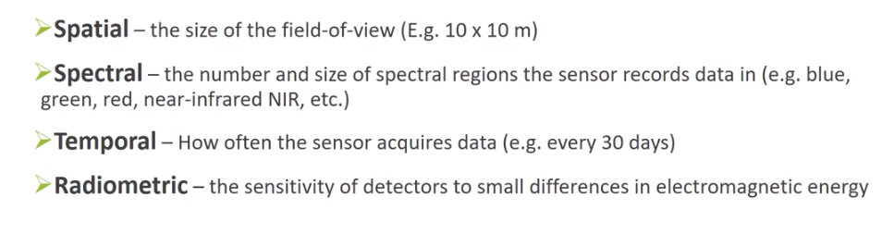

Slide 59
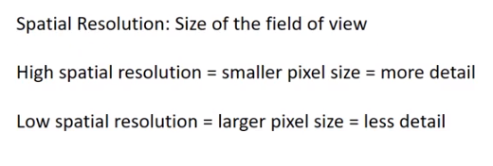
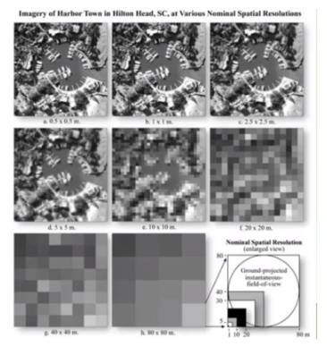

Slide 60
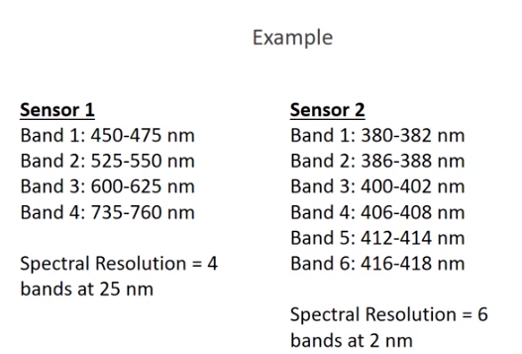
SPECTRAL RESOLUTION
Spectral resolution: spectral band width of the filter and the sensitiveness of the detector.
Ability of a sensor to define fine wavelength intervals or the ability of a sensor to resolve the energy received in a spectral bandwidth to characterize different constituents of earth surface.
The finer the spectral resolution, the narrower the wavelength range for a particular channel or band.

Slide 61
Radiometric resolution
Radiometric resolution: measure of how many grey levels are measured between pure black (no reflectance) to pure white.
In other words, radiometric resolution represents the sensitivity of the sensor to the magnitude of the electromagnetic energy.
The finer the radiometric resolution of a sensor the more sensitive it is to detecting small differences in reflected or emitted energy or in other words the system can measure more number of grey levels.
Radiometric resolution is measured in bits.
Each bit records an exponent of power 2 (e.g. 1 bit →2).

Slide 62
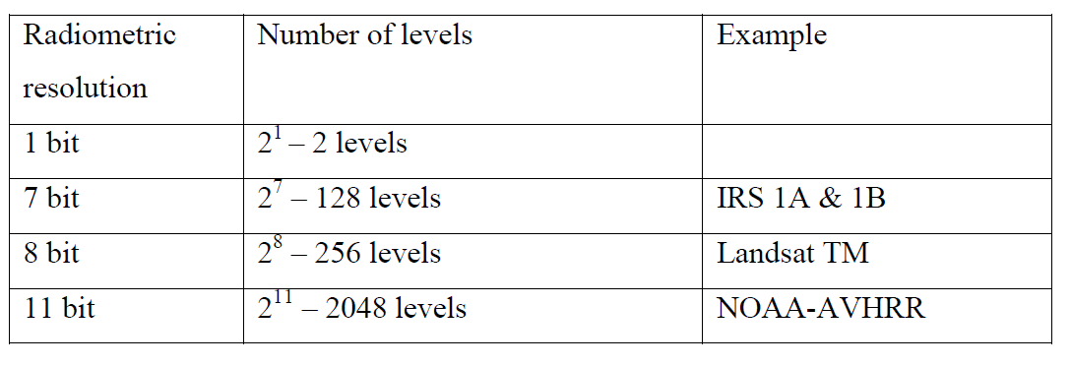

Slide 63
Image data are generally displayed in a range of grey tones, with black representing a digital number of 0 and white representing the maximum value (for example, 255 in 8-bit data).
By comparing a 2-bit image with an 8-bit image, we can see that there is a large difference in the level of detail discernible depending on their radiometric resolutions.
In an 8 bit system, black is measured as 0 and white is measured as 255. The variation between black to white is scaled into 256 classes ranging from 0 to 255.

Slide 65
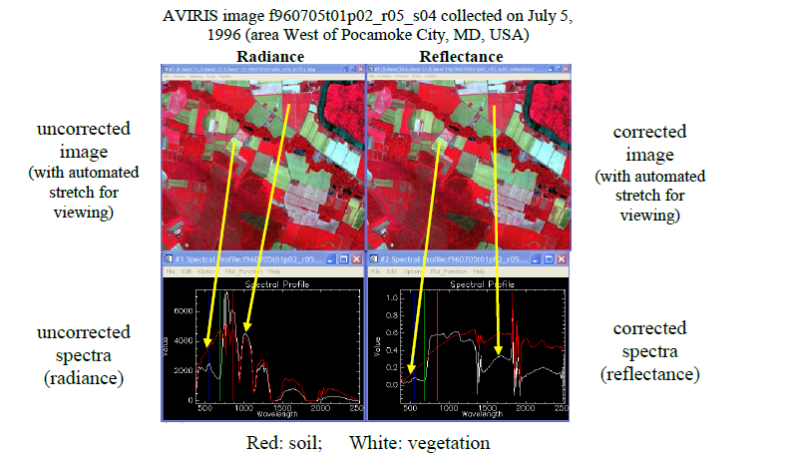
Atmospheric Correction
Spectral Reflectance: If the atmosphere is uniform over the scene, imagery may not appear very different after atmospheric correction, but the spectra of individual targets will usually be very different.

Slide 66
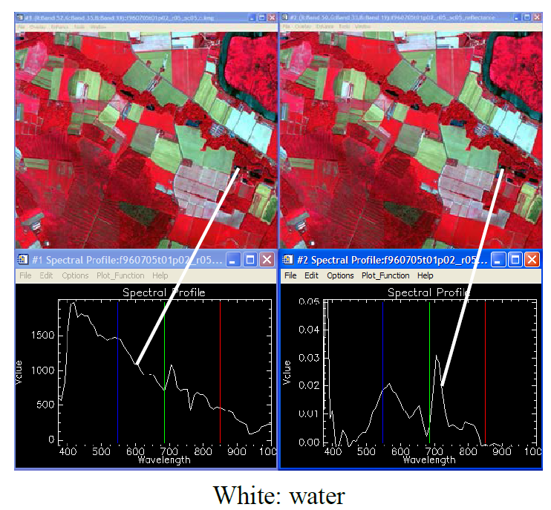

Slide 67
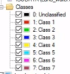
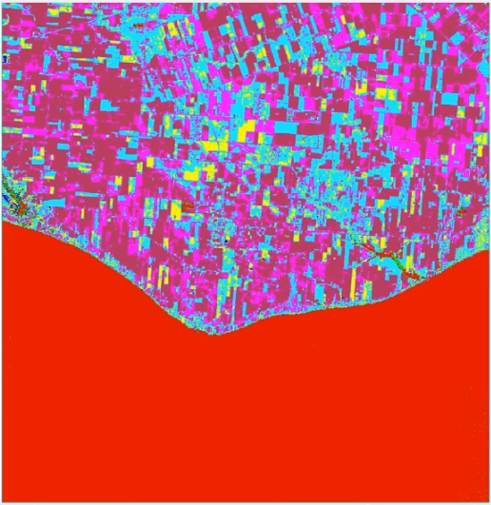
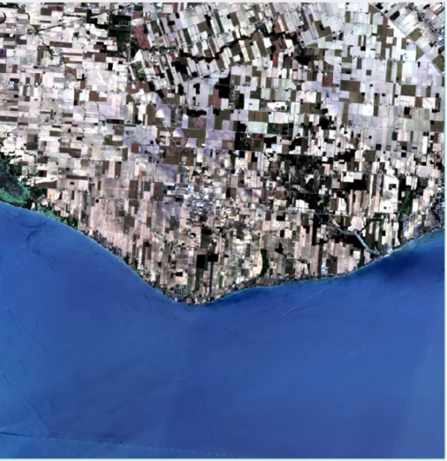
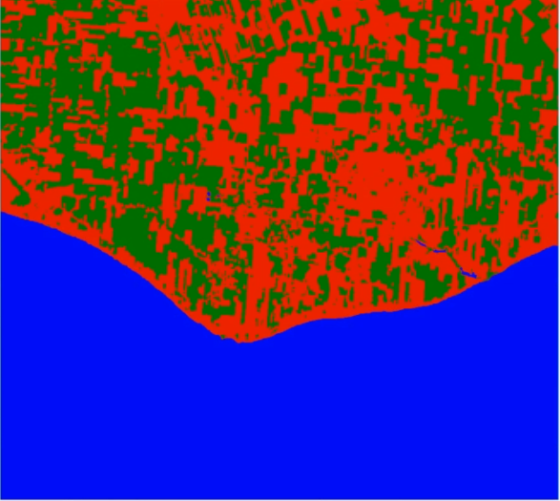
Example
UNSUPERVISED
SUPERVISED

Slide 68
Links:
Sentinel Playground: https://apps.sentinel-hub.com/sentinel-playground/?source=S2L2A&lat=40.4&lng=-3.730000000000018&zoom=12&preset=1_TRUE_COLOR&layers=B01,B02,B03&maxcc=20&gain=1.0&gamma=1.0&time=2021-09-01%7C2022-03-31&atmFilter=&showDates=false
USGS: https://earthexplorer.usgs.gov/

